Slide 1
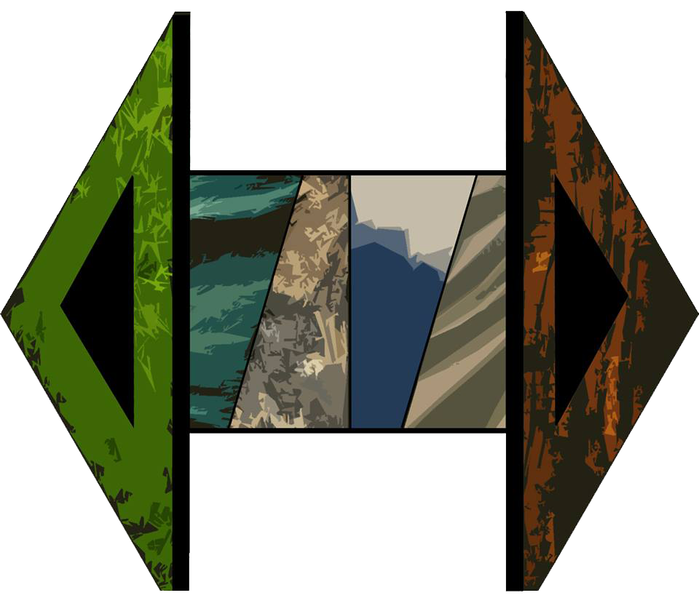
HEXORAL
Hanieh, Lokesh, Orestis, Stefanos, Vitor

Slide 2
Game Introduction
Goal of the game
Currency
Combat mechanics
Strategic placements
RPG elements
Game types

Slide 3
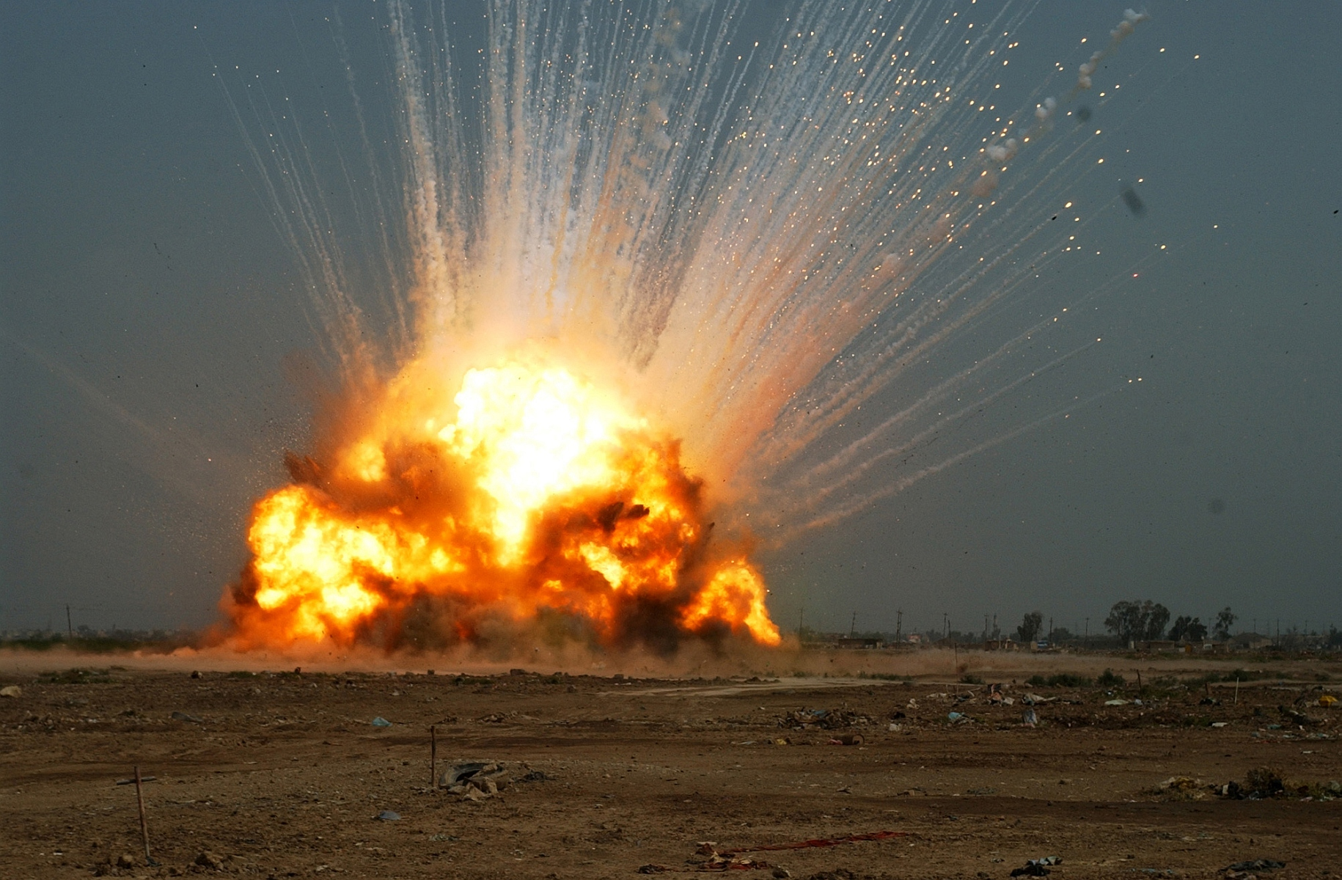
Main goal of the Game
Destroy enemies’ main base (headquarters).

Slide 4
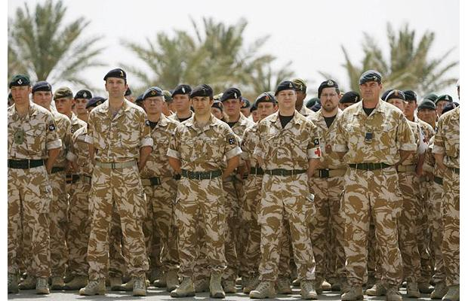


Currency (Soldiers)
All players start with the same amount of soldiers.
To create units you need a certain amount of soldiers in order to purchase a unit.
After every turn each player receives the same amount of soldiers.
There are ways to obtain more soldiers.

Slide 5
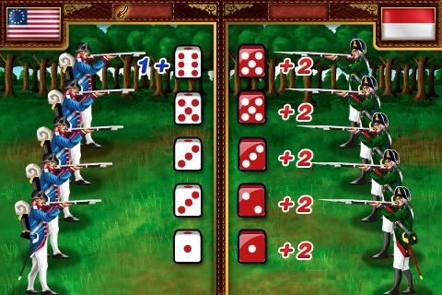
Combat Mechanics
Partially random damage during battles.

Slide 6
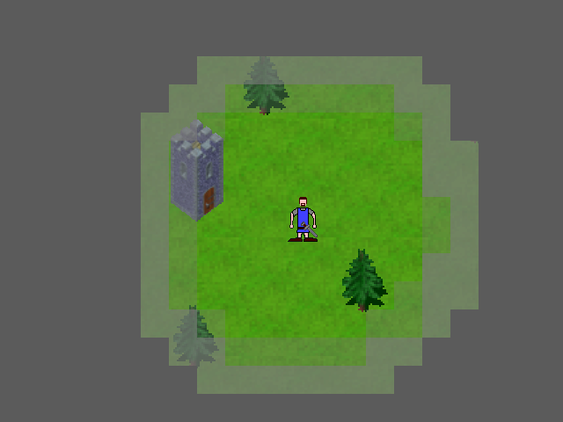
Strategic Placements
Fog of war (restricted visibility) and each unit has a different range of visibility.

Slide 7
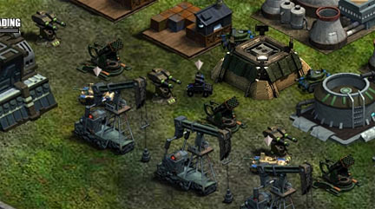
Strategic Placements
Neutral entities in the map which provide extra power if conquered. (extra soldiers per turn, extra bases, extra units etc…)

Slide 8
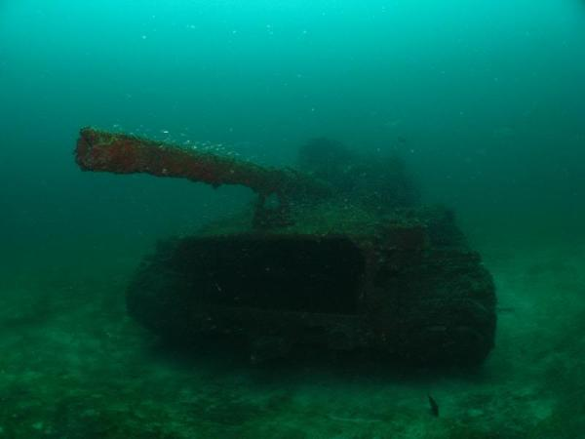

Strategic Placements
Some units have some terrain-specific restrictions. (air, land, sea)

Slide 9

RPG Elements
Winning battles increases your experience level and it enables you to produce more units etc…

Slide 10

Game Types
Time lengths. (3min/turn – 24hrs/turn)

Slide 11
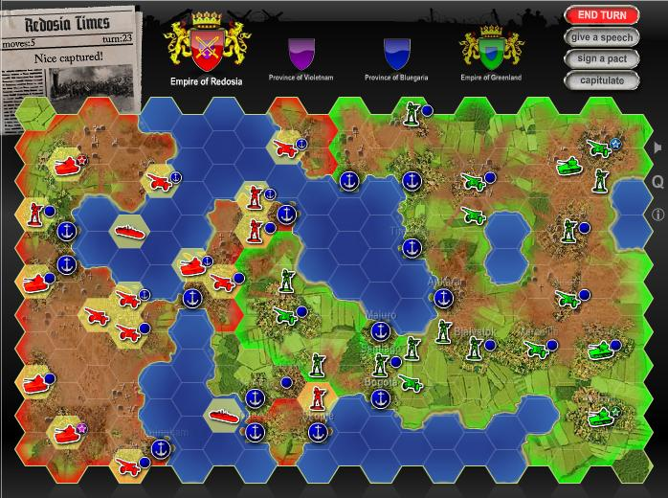
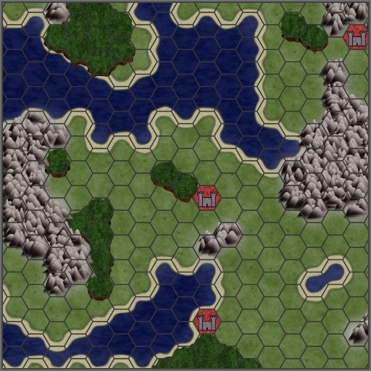
Game Types
Map sizes. (30x30 – 100x100)

Slide 12
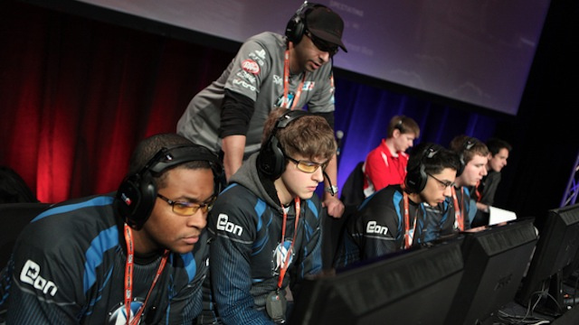
Game Types
Number of players. (1vs1 – 4vs4).

Slide 13
Timeline
Units generation (1 week).
Server Side support
(2 week).
User Interface (1 week).
Map generation (1 week).
Rules/Mechanics of the game (2 week).

